Slide 1
Aspect-Based Sentiment Analysis on Amazon Reviews
Using LLM-Generated Silver Labels and Fine-Tuned ModernBERT
DATA-6900 Capstone
Ramy Qranfal

Slide 2

Background
Amazon has millions of product reviews, but a single review often mentions multiple features with different opinions. Current sentiment analysis tools only give one overall label per review, missing the specific details that sellers need to improve their products.

Slide 3
Problem Statement
Example Review:
“The battery life is great but the sound quality is terrible and the screen is just okay.”
Traditional Sentiment Analysis:
Classifies the entire review as positive, neutral, or negative. Misses the key aspect-sentiment pair details.
Aspect-Based Sentiment Analysis (ABSA):
Extracts each product aspect and classifies their sentiments separately. Sellers can see exactly which features customers like and dislike.

Slide 4
Methodology and Approach
Download Amazon Reviews 2023 for 5 categories: Electronics, Beauty and Personal Care, Video Games, Amazon Fashion, and Books
Hold out 100 reviews (20 per category) as manual validation set (before any training)
Sample 2000 reviews per category (10000 total) using stratified sampling by sub-category
Run each review through Llama 3 8B locally to extract aspect-sentiment pairs
Format as "review [SEP] aspect" and split 80/10/10 for training
Fine-tune ModernBERT to classify sentiment given each aspect-sentiment pair
Compare against baselines (Logistic Regression, SVM, Random Forest, Stacking, Direct Llama Calling)

Slide 5
Dataset Overview
Category | Positive | Neutral | Negative | Total
Electronics | 4,242 | 1,280 | 1,726 | 7,248
Beauty and Personal Care | 5,494 | 1,692 | 1,715 | 8,901
Video Games | 3,650 | 1,176 | 1,965 | 6,791
Amazon Fashion | 3,787 | 1,038 | 1,647 | 6,472
Books | 4,617 | 1,814 | 1,399 | 7,830
Total | 21,790 | 7,000 | 8,452 | 37,242
Beauty and Personal Care produced the highest number of aspect-sentiment pairs, and Amazon Fashion the lowest
Reviews containing fewer than 10 words were excluded during preprocessing
Each review produced three to four aspect-sentiment pairs on average

Slide 6
Label Agreement Rate
Category | Labels Checked | Agreement
Electronics | 70 | 94.3%
Beauty and Personal Care | 92 | 100%
Video Games | 89 | 100%
Amazon Fashion | 34 | 100%
Books | 100 | 100%
Llama 3 8B labeled the 100 reviews in the manual verification set, then every label was checked against the review text and corrected where wrong
Agreement is at least 94% per category, above the 80% target set in the proposal
This level of agreement supports the use of the silver labels as training data

Slide 7
Fine-Tuned ModernBERT Results
Accuracy | F1 Macro | Precision | Recall | ROC-AUC
0.767 | 0.693 | 0.710 | 0.680 | 0.882
Fine-tuned for 3 epochs locally on RTX 4080 Super
Batch size 16, learning rate 2e-5, mixed precision training
Added three classification head at top for positive, neutral and negative sentiment
An ROC-AUC of 0.882 indicates strong separation between the three sentiment classes

Slide 8
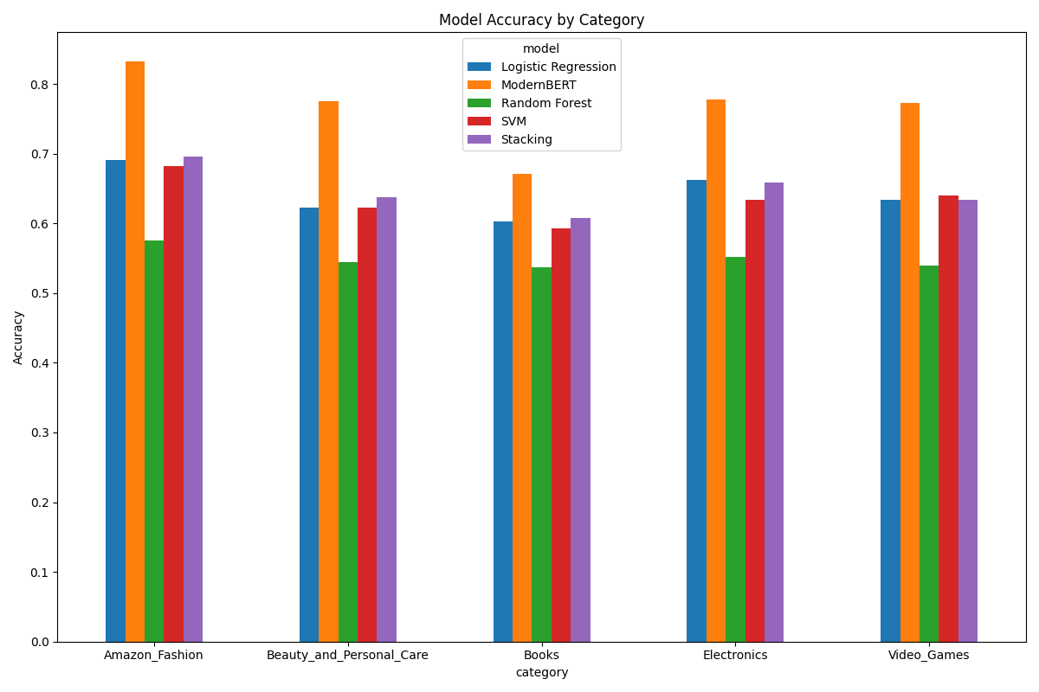
Per Category ModernBERT Performance
Performance is consistent across all five categories, which shows the approach generalizes to different product types
Amazon Fashion achieved the highest accuracy and Books the lowest

Slide 9
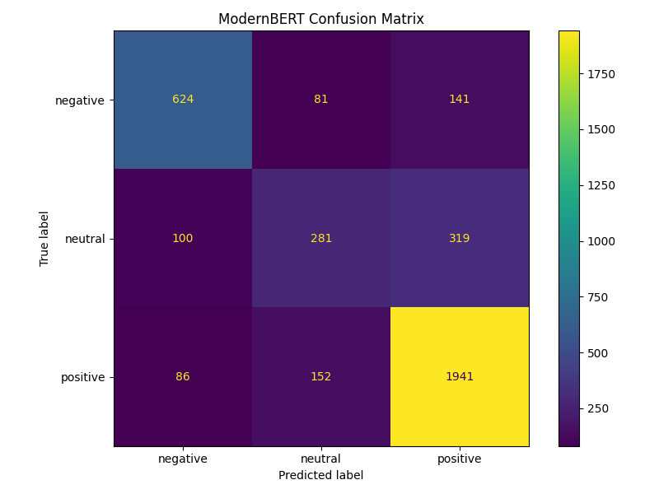
Confusion Matrix
Most misclassifications are between the neutral and positive classes
Neutral is the smallest class at 7,000 out of 37,242 pairs
Neutral is also harder to define, since it covers a wider range of wording than positive or negative

Slide 10
Training Data Size Comparison
Training Examples | Accuracy | F1 Macro
5,000 | 0.689 | 0.560
29,793 | 0.767 | 0.693
A second model was trained on 5000 examples using identical hyperparameters
Reducing the training set to 17 percent of its original size lowered accuracy by approximately 8 points and F1 Macro by 0.13
This shows the full training set made a real difference to model performance

Slide 11
Baseline Models Comparison
Model | Accuracy | F1 Macro | ROC-AUC
ModernBERT | 0.767 | 0.693 | 0.882
Logistic Regression | 0.643 | 0.456 | 0.705
SVM | 0.635 | 0.407 | 0.690
Random Forest | 0.550 | 0.443 | 0.640
Stacking Ensemble | 0.647 | 0.435 | 0.717
Stacking achieved the highest accuracy among the traditional models, though Logistic Regression scored highest on F1 Macro
Fine-tuned ModernBERT beats all traditional baselines, and the gap is largest on F1 Macro
The traditional models achieve accuracy largely by favoring the majority positive class, a weakness that F1 Macro makes visible

Slide 12
Direct Llama 3 8B Comparison
Model | Accuracy | F1 Macro | Reviews/sec
ModernBERT | 0.767 | 0.693 | 249
Direct Llama 3 8B | 0.978 | 0.973 | 0.82
The test labels were generated by Llama 3 8B, so this result reflects self-consistency rather than independent accuracy
It should therefore be interpreted as an upper bound on this evaluation rather than a competing baseline
ModernBERT processes reviews around 300 times faster, which is what matters when running at scale

Slide 13
Overall Training Time
Stage | Time
Silver label generation (10,000 reviews) | 94.5 min
ModernBERT fine-tuning (3 epochs) | 10.4 min
All four baselines combined | 2.1 min
Direct Llama inference (500 reviews) | 10.1 min
Silver label generation took the longest at about 95 minutes using 8 parallel workers
ModernBERT training took about 3 minutes per epoch
Labeling one review at a time would have taken around 8 hours instead of 95 minutes

Slide 14
Aspect Rankings by Category
Category | Aspect | Score
Electronics | value | +0.92
Electronics | instructions | -0.60
Amazon Fashion | cute design | +1.00
Amazon Fashion | sizing | -0.45
Books | humor | +0.91
Books | pacing | -0.23
Each aspect is scored as the share of positive mentions minus the share of negative mentions
Only aspects mentioned at least 20 times are included
This is the output a seller would use directly to decide what to improve

Slide 15
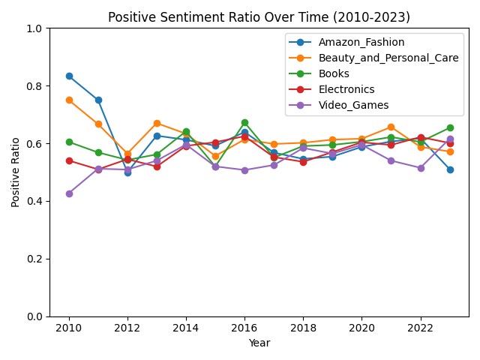
Temporal Trend Analysis
No category shows a real trend, sentiment stays stable across the period
Early years vary more because fewer reviews fall in those years

Slide 16
Challenges
Groq API free tier could not handle 10,000 reviews, so Llama 3 8B was moved to run locally through Ollama
Llama sometimes returned sentiments outside the three classes, such as "mixed", which needed a cleaning step
Direct Llama scored 97.8%, but the test labels came from Llama itself, so the comparison was circular

Slide 17
Limitations
There is no gold-labeled test set, so every metric is measured against Llama's own labels
The manual validation set is only 100 reviews, which is a sanity check rather than a firm estimate
No hyperparameter search was run, so 76.7% reflects standard defaults rather than a tuned ceiling
Sub-category extraction often returned Unknown, which weakened the stratified sampling

Slide 18
Future Work
Build a hand-labeled test set that is fully independent of the LLM
Run a proper learning rate and batch size search on the fine-tuning stage
Fix the metadata parsing so stratified sampling covers sub-categories evenly
Expand the manual validation set to cover more sub-categories

Slide 19
Conclusion
An LLM can generate the aspect-level training labels that normally require manual labeling
A much smaller model trained on those labels reaches 76.7% accuracy and 0.693 F1 Macro
ModernBERT outperforms all traditional baselines while running around 300 times faster than the LLM
Label agreement of 94% or higher supports the reliability of the silver labeling approach

